Slide 1

Homework Computational Logic
Iliescu Andrei

Slide 2
Problem statement - Exercise 4
Consider the following set of hypotheses { H₁, H₂, H₃, H₄, H₅, H₆ } and check the validity of the conclusion ( C ) using the definition of deduction and the appropriate inference rules.
H₁ . Every child loves Santa.
H₂ . Everyone who loves Santa loves any reindeer.
H₃ . Rudolph is a reindeer, and Rudolph has a red nose.
H₄ . Anything which has a red nose is weird or is a clown.
H₅ . No reindeer is a clown.
H₆ . Scrooge does not love anything which is weird.
C . Scrooge is not a child.
H₁, H₂, H₃, H₄, H₅, H₆ ├ C

Slide 3
Theoretical results
Deduction
Let U₁, U₂, U₃, … ,U_{n} be first-order formulas, called hypotheses and V, called conclusion. V is deducible (inferable) from U₁, U₂, U₃, … ,U_{n} and we denote by U₁, U₂, U₃, … ,U_{n}├ V, if there exists a sequence (f₁, f₂, … , f_{n}) of formulas such that f_{m} = V and ∀i ∈ {1, … , m} we have a), b), c), or d):
f_{i} ∈ A_{pr} (axiom of predicate logic)
f_{i} ∈ { U₁, U₂, U₃, … ,U_{n} } (hypothesis formula)
f_{i1}, f_{i2}├ _{mp} f_{i}, i₁ < i and i₂ < I (modus ponens)
f_{j} ├_{gen} f_{i} , j < I (universal generalization)
A_{pr} = { A₁, A₂, A₃, A₄, A₅ } is the set of axioms
A₁: U → (V → U)
A₂: (U → (V → Z)) → ((U → V) → (U → Z))
A₃: (U → V) → (¬V → ¬U) (modus tollens)
A₄: (∀x)U(x) → U(t) (universal instantiation)
A₅: (U → V(y)) → (U → (∀x)V(x))

Slide 4
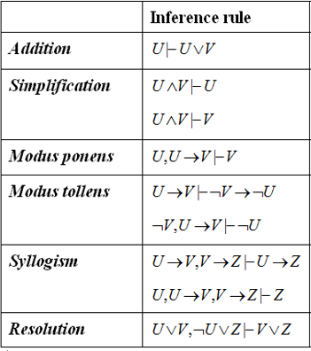
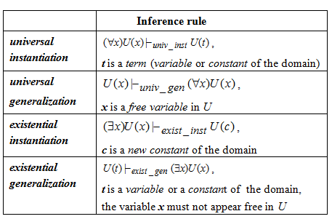
Theoretical results

Slide 5
Modelling reasoning
D is the domain (all living things).
Rudolph, Santa and Scrooge are constants of the domain.
Predicate symbols: cd, lv, rd, rn, w, c
ch: D → { T, F }, ch(x) = T if x is a child
lv: D X D → { T, F }, lv(x,y) = T if x loves y
rd: D → { T, F }, rd(x) = T if x is a reindeer
rn: D → { T, F }, rn(x) = T if x has a red nose
w: D → { T, F }, w(x) = T if x is weird
c: D → { T, F }, c(x) = T if x is a clown
Hypotheses
H₁ . Every child loves Santa.
H₂ . Everyone who loves Santa loves any reindeer.
H₃ . Rudolph is a reindeer, and Rudolph has a red nose.
H₄ . Anything which has a red nose is weird or is a clown.
H₅ . No reindeer is a clown.
H₆ . Scrooge does not love anything which is weird.
Conclusion
C . Scrooge is not a child.
H₁: (∀x)( ch(x) → lv(x, Santa) )
H₂: (∀x)(∀y)( lv(x, Santa) → (rd(y) → lv(x,y))
H₃: rd(Rud) ∧ rn(Rud)
H₄: (∀x)( rn(x) → ( w(x) ∨ c(x) ) )
H₅: ¬(∃x)( rd(x) ∧ c(x) ) ≡ (∀x)( rd(x) → ¬c(x) )
H₆: (∀x) (w(x) → ¬lv(Scrooge,x))
C: ¬ch(Scrooge)

Slide 6
H₁├_{univ_inst, Scrooge} ch(Scr) → lv(Scr,Santa) : f₇ (universal instantiation)
H₂├_{univ_inst, Scrooge}(∀y)(lv(Scr,Santa) → (rd(y) → lv(Scr,y))) : f₈’ (universal instantiation)
f₈’├_{univ_inst, Rudolph} lv(Scr,Santa) → (rd(Rud) → lv(Scr,Rud)) : f₈
f_{8:}: lv(Scr,Santa) → (rd(Rud) → lv(Scr,Rud)) ≡ lv(Scr,Santa) ∧ rd(Rud) → lv(Scr,Rud) : f₉
H₄├_{univ_inst, Rudolph} rn(Rud) → ( w(Rud) ∨ c(Rud) ) : f₁₀ (universal instantiation)
H₃├ rn(Rud) : f₁₁ (simplification)
f₁₁, f₁₀ ├_{mp} w(Rud) ∨ c(Rud) : f₁₂ (modus ponens)
H₅├_{univ_inst, Rudolph} rd(Rud) → ¬c(Rud) : f₁₃ (universal instantiation)
H₃├ rd(Rud) : f₁₄ (simplification)
f₁₄, f₁₃ ├_{mp} ¬c(Rud) : f₁₅ (modus ponens)
f₁₂: w(Rud) ∨ c(Rud) ≡ ¬w(Rud) → c(Rud)
f₁₅, f₁₂ ├_{mt} ¬(¬w(Rud)) ≡ w(Rud) : f₁₆ (modus tollens)
H₆ ├_{univ_inst, Rudolph} w(Rud) → ¬lv(Scrooge, Rud) : f₁₇ (universal instantiation)
f₁₆, f₁₇ ├_{mp} ¬lv(Scrooge, Rud) : f₁₈ (modus ponens)
f_{8,}f₁₈ ├_{mt} ¬ (lv(Scr,Santa) ∧ rd(Rud) ) ≡ ¬ lv(Scr,Santa) ∨ ¬ rd(Rud) ≡ rd(Rud) → ¬ lv(Scr,Santa) : f₁₉
f_{14,} f₁₉ ├_{mp} ¬ lv(Scr,Santa) : f₂₀ (modus ponens)
f₂₀, f₉ ├_{mt} ¬ch(Scr) : C (modus tollens)
H₁: (∀x)( ch(x) → lv(x, Santa) )
H₂: (∀x)(∀y)( lv(x, Santa) → (rd(y) → lv(x,y))
H₃: rd(Rud) ∧ rn(Rud)
H₄: (∀x)( rn(x) → ( w(x) ∨ c(x) ) )
H₅: ¬(∃x)( rd(x) ∧ c(x) ) ≡ (∀x)( rd(x) → ¬c(x) )
H₆: (∀x) (w(x) → ¬lv(Scrooge,x))
C: ¬ch(Scrooge)

Slide 7
Conclusion
In conclusion H₁, H₂, H₃, H₄, H₅, H₆ ├ C
C is a valid conclusion.

